Slide 1
#vCommunity Benefits for you, your team and your town
By @arielsanchezmor
@importcarguy
V1.0

Slide 2
Agenda
My story
How you can take advantage
- Typical evolution
- Different methods
- Find a way to contribute
- Benefits
How will this help my team too?
How will this improve my town?

Slide 3
A favor
Take a pic during this session. Anything you want – the stage, your co-worker, I encourage selfies
We’ll do something with it near the end ☺

Slide 4

vCommunity

Slide 5
My story
Costa Rican Resume stuff VMware - I liked it! 4 engineers were playing with it and I was the JR Convinced boss to send me to class (VMUG)
Bought myself a book, Scott Lowe's Mastering vSphere 5
VCP! YEAHH

Slide 6
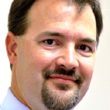
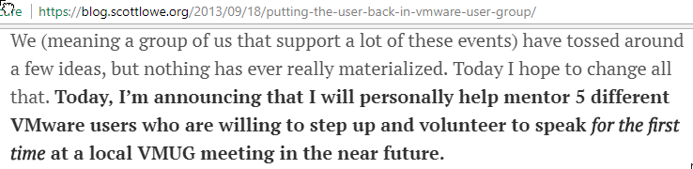
This literally changed my career
blog.scottlowe.org
@scott_lowe
Super nice guy
I started using Twitter

Slide 7
Move to NYC
UserCon Got to know the leaders, Mike Foley Company got acquired, became VMware engineer mainly VCAP, book, Google+
First real vCommunity moment - a random twitter guy gave me a VCAP voucher! And I passed it!

Slide 8
Enough Ariel
Won't bore you with more details - but you can see that this wasn't too difficult, just a little willingness on my part changed my career for the way better.
So where and how exactly can you participate and take advantage of this vCommunity thing?

Slide 9
4 stages of participation
-lurk
-‎interact
-‎contribute
-‎mentor? Idk PUSH OTHERS

Slide 10
Different ways to do it
All thanks to the magic of the internet.
Most of the IT world speaks english
The most important to me is twitter
-global directory of people -‎tailored news -‎hashtags are powerful

Slide 11
Ways to start communicating
VMTN -forums
-‎podcast
-blogs.vmware.com Reading and commenting on other’s blogs

Slide 12
You kinda knew this, I know
VMUG -learn -‎connect -‎discover -‎critical: reach out to the VMUG leaders, that they know you and offer them to present in the future

Slide 13
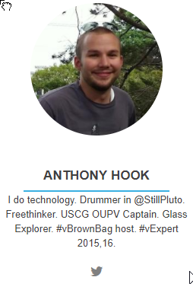
vBrownBag = the best thing
By engineers, for engineers (Cody Bunch, Alastair)
Helping others is cool
it's not all vendor fueled
TechTalks, Meet X, Commitmas
Cert-specific tracks, AWS
Latin America, Europe and Brasil

Slide 14
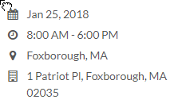
Be nice Ariel
Other virtualization user groups
We’re at VMUG but I do go, around AFC championship time, to Foxboro #GoPats
There’s Meetups for every tech

Slide 15
Podcasts
Podcasts -Have a long commute? I ENVY YOU
@ExploreVM and @vGigaCast are from WI! -‎Bunch of famous ones but I REALLY like Geek Whisperers

Slide 16
LinkedIn
Great if:
This isn’t formal enough for you
You want to make LinkedIn your platform
There’s some good groups like VCP
If you create anything, you can send to multiple social tools

Slide 17
Slacks
If you’ve never used it, here’s my #1 tip:
Don’t run it as a webpage. Install the app and especially on your phone
VMware Code is free and automation/programming related, which, be honest, you should get better at

Slide 18
Scheduled events
Virtual events, sure
VMworld is really cool, especially when you realize it’s not about the sessions!
Talk to people
Hang out in the common areas
Check twitter
Tailor the event so that you get what you want, but you also get pushed!

Slide 19
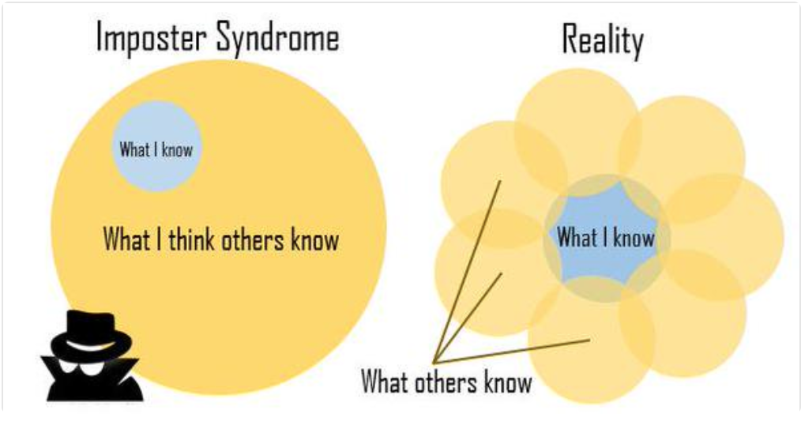
Contributing
Getting past "I don't know anything"

Slide 20
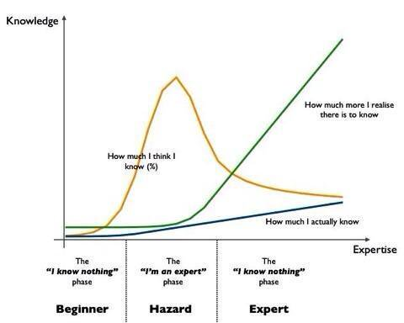
We’re all on our own journey

Slide 21
‎failure is temporary!
Contributing is crucial
You will learn so much more by teaching others
Presenting itself is something that takes practice to do well
Just try to get better each time. That’s all!

Slide 22
Attitudes that build
This is a bigger discussion, but you will find a lot of good attitudes in the vCommunity
Everyone brings something to the table
1) Positivism -let's try it -I'll help you get there

Slide 23
Attitudes that build
2) Frankness -‎If you think I'm wrong, that's ok! Show me, I want to get better -‎I would rather you tell me now than wait
3) Respect -‎always be nice and treat others like you would like to be treated -Really caring about people. Jobs change, friends can last forever

Slide 24
Easy ways to start
You feel you need to learn more? Volunteer at work to help in the difficult VMware projects
You’re learning enough? Take notes, sanitize the data for internet, and blog about it
Can’t really test and do stuff at work? Homelab! VMUG Advantage great value
$12 domains.google.com Blogger, wordpress.com, GitHub pages

Slide 25
Present at User Meetings and Groups
-‎VMUGs duh
-whiteboard sessions - Internal ‎lunch and learns
Record yourself and put it on YouTube ☺

Slide 26
Share your scripts
As open source if you can -everybody steals shares -powerCLI or esxcli -API/SDK interactions -‎VMware Code Sample Exchange

Slide 27
Help organize meetups, local or online
All of these, twitter hashtags!
-vBeers -vBrisket -‎vCurry -‎vChicken -‎vCoffee -‎vAnime -‎vFitbit -‎vGamers (vgamers.gg)

Slide 28
Become a VMUG leader
People change jobs, reliable new leaders that see ways to improve things are always welcome
-Be responsive and responsible -‎Understand that you have to cater both to new, medium and old attendees

Slide 29
Submit CFPs
Call For Papers is typically some months before a conf
If you think you *could* talk about something for 40 minutes, then please submit! You don't need to have it ready! -Title -Key takeaways -Summary

Slide 30
BENEFITS
All of this will bring you -Friends -‎Contacts for when you need help -‎Opportunity to apply for vExpert and other Vendor sponsored programs -‎lots of new knowledge -‎Knowing who knows about X -‎access to career mentors

Slide 31
Vendor awards
vExpert Veeam Vanguard EMC, Cisco, RedHat, etc Free licenses and subscriptions Swag Private events Beta and feedback groups

Slide 32
Not all vendor
Unexpected freebies, some vendor, others sponsored by vCommunity peeps themselves! -Conf passes -Buddies with who to split costs -Stickers and swag -Books
Vouchers heh

Slide 33
So how does this help my team?
You will notice 3 things: -you could be doing things better -‎you see the value in having frank (but good-intentioned) discussions and doing things like whiteboard or test stuff with colleagues -‎ you learn that knowledge hoarding is a negative value
- the more you share, the better it is for everyone, especially yourself!

Slide 34
Learn how others do IT
IT burnout is avoidable!
Once you learn more, share it. Learn about working in Pilot/Co-Pilot, so that you can have real vacations and off time. You can only do new things if you stop doing old things.

Slide 35
Don’t accept a job you don’t love
Hate your current job? Give it to someone else who wants to learn it, collaboratively improve it during the handoff, and find something you really like!
Sometimes you can, sometimes you can't, but work towards your happiness always, it makes a difference for you and your co-workers

Slide 36
Improving your town
I know. Not everyone wants to do all of this stuff. Would rather do _insert here_ But! Even if you only do this at the local level, it will be awesome and it will matter!
Lots of VMUG leaders are not especially active online Lots of really smart SEs and engineers only shine through their work Lots of people live kinda far from a central point

Slide 37
Do vCommunity however you can
Host smaller meetings closer to you -dont need a sponsor -‎just a whiteboard and some chairs (typical office) -‎however small, publicize and share -‎ could be 3 guys having coffee, or burger/beer

Slide 38
This is what matters
When you want to keep having a conversation with someone, let them know. Offer to make the next meeting with them easy (pay for coffee, etc). Don't be shy to approach people Don't be afraid to be the one-eyed leading the blind. Help people new to VMware to not make your mistakes

Slide 39
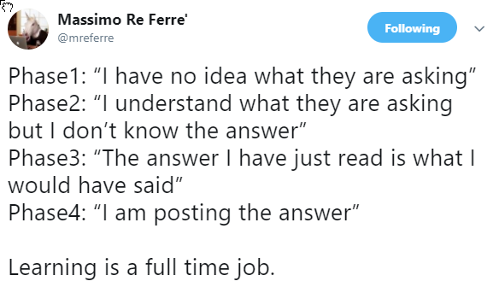
Some parting thoughts

Slide 40
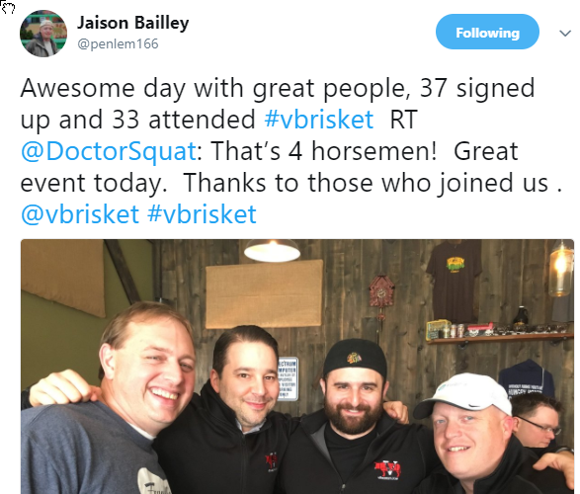

Slide 41
Activity time!
Now, who has twitter? @ to tag someone (they get a notification) # to tag a topic (this #something is searchable) DM is a private message (can be multiuser) @ncwivmug
@wivmug
@importcarguy
@arielsanchezmor
@myvmug

Slide 42
Can I help you get started?
Post the pic with the hashtag #vCommunity and i'll follow you. If we follow each other, we will be able to send private messages as well
I especially want to know if I can help you in any way. If anything you saw is a "thing you'd like to achieve" I'll help you get there! Let's grab some time today after this!

Slide 43
We’re done ☺
Give feedback in the tool, and give feedback to me ☺

